Slide 1
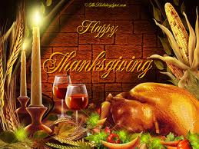

Slide 2
Brief History of Thanksgiving
Thanksgiving = “The Day for Giving Thanks”
In the 1500s, a group of English Pilgrims (Protestants) left England so they could practice their religion
In the Americas, the Native Americans taught them to fish, to hunt and to grow vegetables
In 1621, the Native Americans and Pilgrims had a 3-day feast in the fall to give thanks for a strong harvest
Always celebrated on the 4th Thursday of November

Slide 3
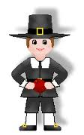
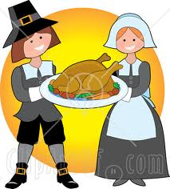
Usual Depictions of Pilgrims

Slide 4
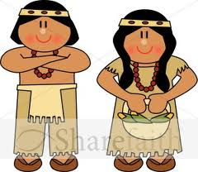
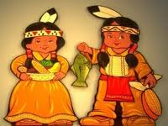
Usual Depictions of Native Americans

Slide 5
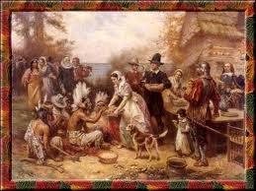
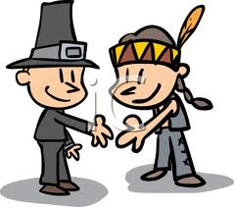
Together…

Slide 6
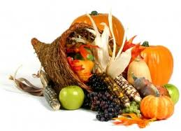
Cornucopia or “Horn of Plenty”

Slide 7
Thanksgiving Traditions…

Slide 8
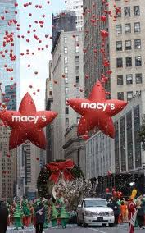
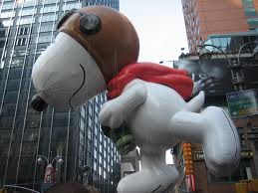
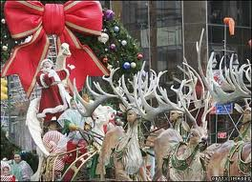
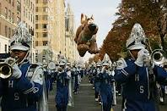
Macy’s Thanksgiving Day Parade in NY

Slide 9
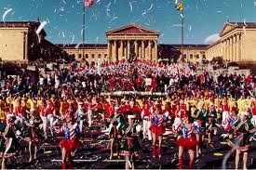
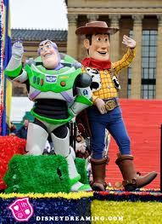
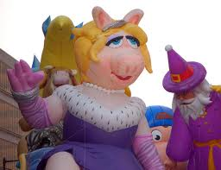
Philadelphia Thanksgiving Day Parade

Slide 10
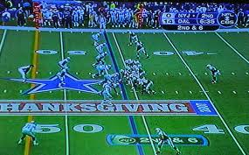
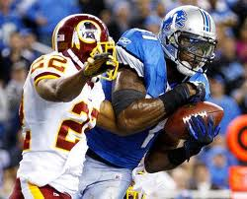
Ugh. American Football
Dallas Cowboys
Detroit Lions

Slide 11
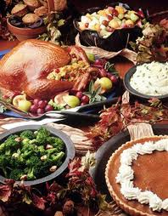
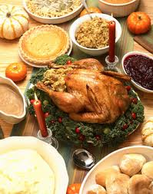
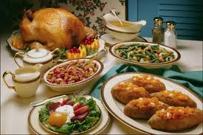
Thanksgiving Day Feast!

Slide 12
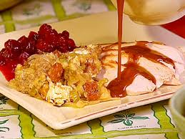
Turkey with Gravy and Stuffing

Slide 13
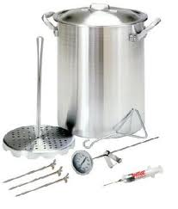
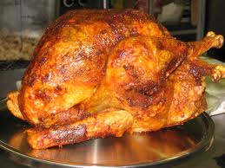
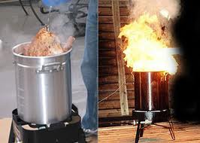
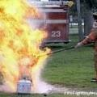
Deep-Fried Turkey = Bad Idea

Slide 14
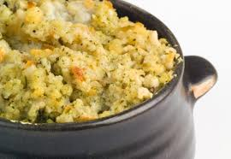
Stuffing

Slide 15
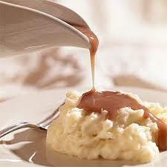
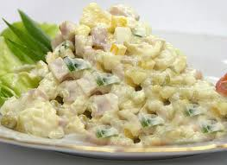
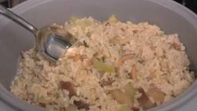
Other Thanksgiving Staples:
Mashed Potatoes
Potato Salad
Rice

Slide 16
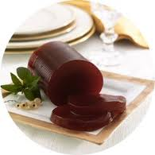
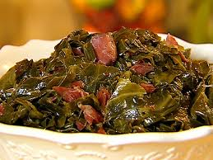
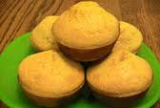
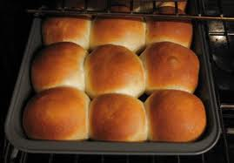
Typical Side Dishes:
Cranberry Sauce
Collard Greens
Cornbread
Dinner Rolls

Slide 17
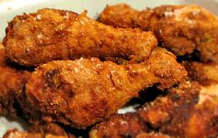
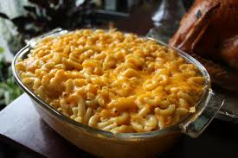
New Thanksgiving Dishes
Fried Chicken
Macaroni and Cheese

Slide 18
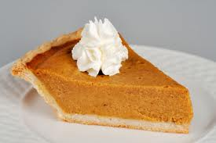
Desserts!!
Sweet Potato Pie

Slide 19
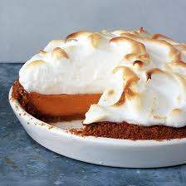
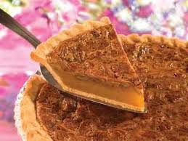
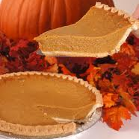
Desserts!
Candied Yams
Pecan Pie
Pumpkin Pie

Slide 20
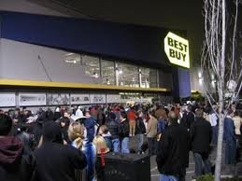

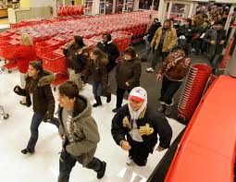

Black Friday

Slide 21

The dark side of Thanksgiving
Europeans would take the Natives’ land
Give them “gifts” of blankets (with smallpox)
Eventually force many Native Americans onto reservations

