Slide 1
Valentine’s Day
February 14th

Slide 2
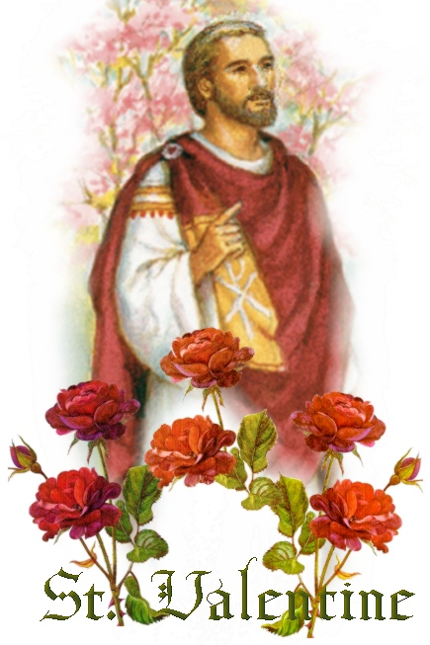
History of Valentine’s Day

Slide 3

Origins of Valentine’s Day
Many saints named Valentine
  1st: secretly married young couples when it was illegal to marry in Ancient Rome
  2nd: thrown in prison. He wrote love letters and signed them “From Your Valentine”
Some countries celebrate Valentine’s Day on different days: July 6th, or July 30th

Slide 4
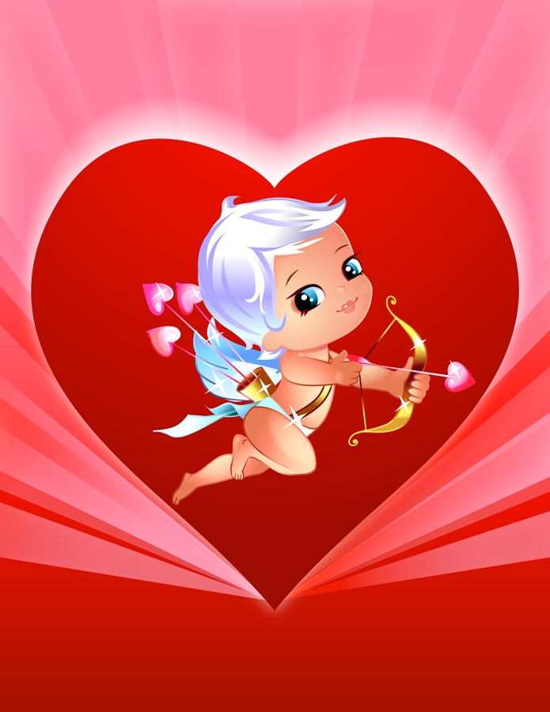
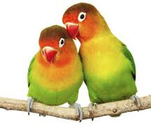
Typical Valentine’s Day Symbols

Slide 5
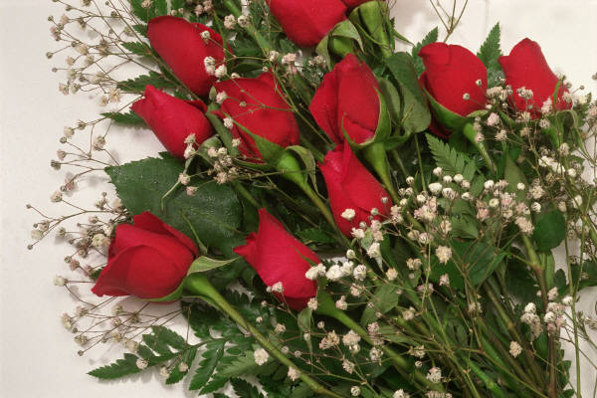

Roses
  Red: Romantic love, Sincere love
  Pink: Admiration, Romance, Beauty
  Yellow: Friendship, Happiness, Joy (Jealousy)
  White: Purity, Loyalty, Sincerity, Happiness (weddings)
  Lavender: Love at 1st Sight

Slide 6
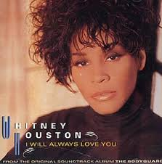
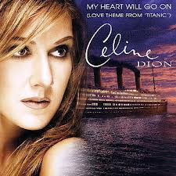
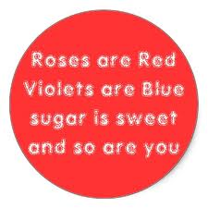
Poems/Songs

Slide 7
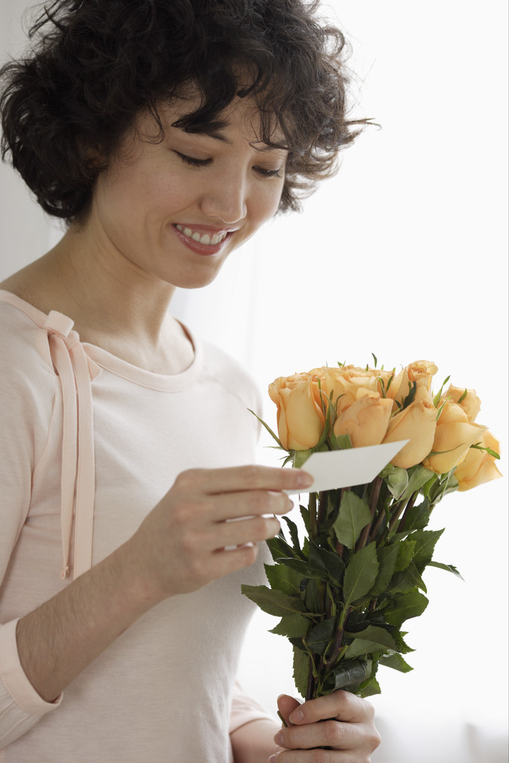
Cards
People used to write letters, but now they use printed cards with a message on it
Anyone (rich or poor) could send them
1,000,000,000 cards sent each year

Slide 8
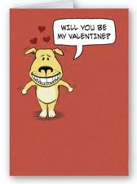
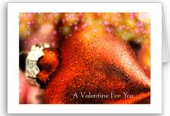
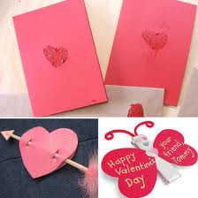
Cards

Slide 9

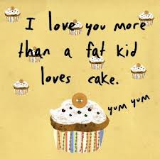
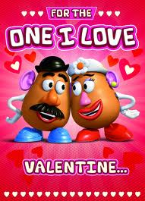
Cards

Slide 10
Candy (Chocolate)
Way to make the message “sweeter”
  Americans love sugar
In 1895 the first Hershey bar was made
  Before chocolate was very expensive
Many people began to give chocolate as a present

Slide 11
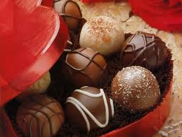
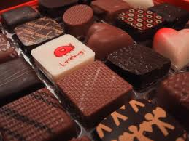
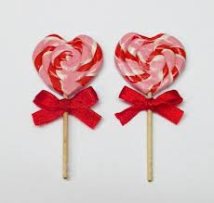
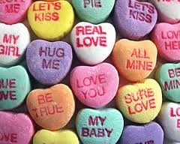
Candy

Slide 12
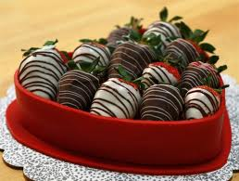
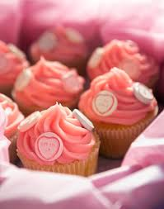

More Candy

Slide 13
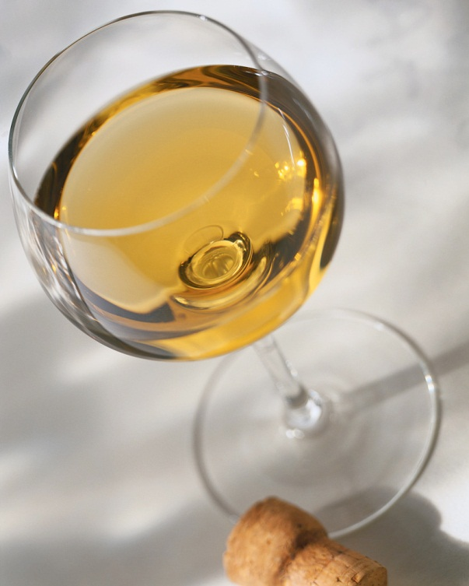
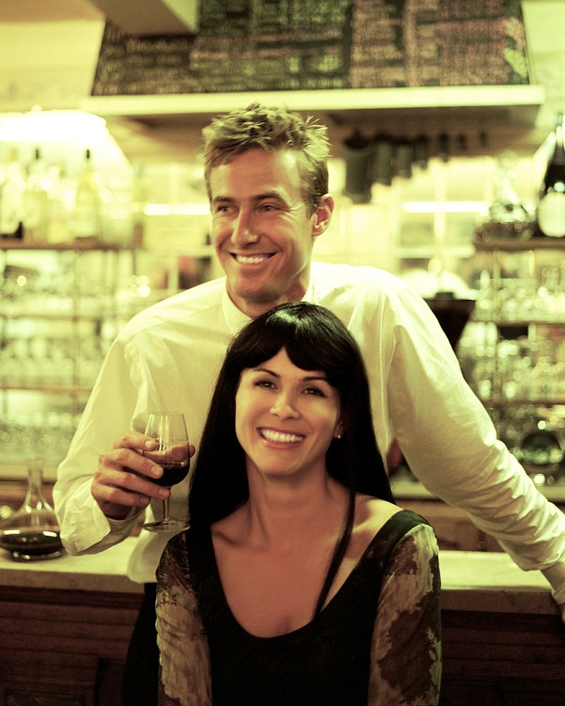
Dinner at a restaurant
Couples can have a special dinner and a nice date
They usually pay more for dinner that night
It’s actually not a good day to go out to eat. Who can guess why?

Slide 14
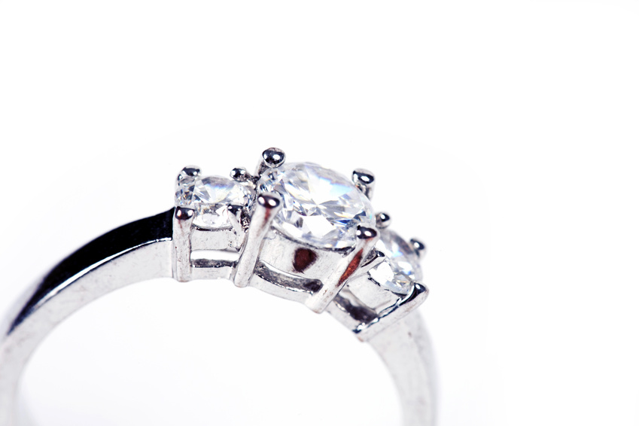
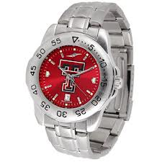
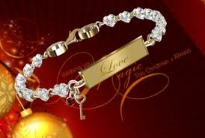
Jewelry
Both men and women get jewelry on Valentine’s Day

Slide 15
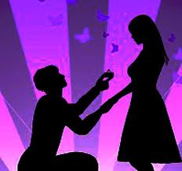
Marriage Proposals
Only 2 million will get engaged
http://www.youtube.com/watch?v=rtBVsCPEy1c
6 million people think they will get engaged on Valentine’s Day

Slide 16

Valentine’s Day Movies
Recently, more couples are staying home on Valentine’s Day (who can guess why?)
They make dinner or order dinner and watch a movie
Almost all movies watched on Valentine’s Day are “rom-coms”
Guys are very patient

Slide 17

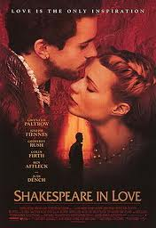
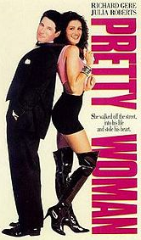
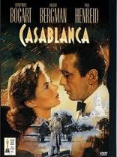
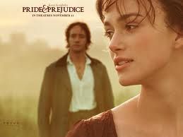
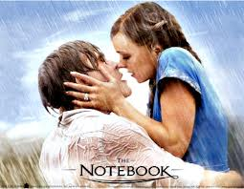
A few classic Valentine’s Day movies

Slide 18
Clips from some Valentine’s Day movies:
The Notebook
Shakespeare In Love
Pride and Prejudice
Pretty Woman
Casablanca

Slide 19
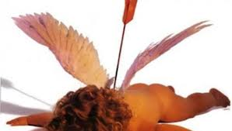
Anti-Valentine’s Day
Some people do not want to (or refuse to) celebrate Valentine’s Day
  They were hurt or dumped recently
  They think the flowers, cards, and candy companies made up a holiday for money

Slide 20
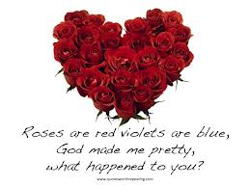
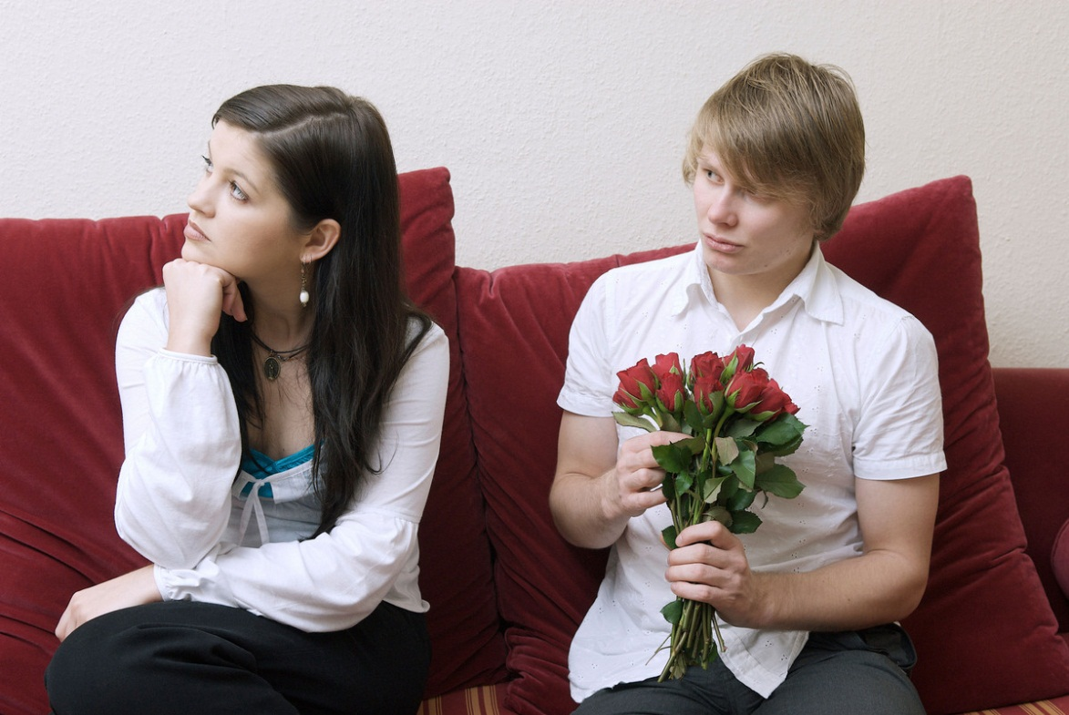
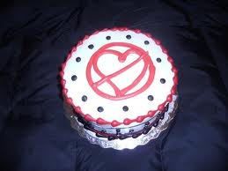

Slide 21

How will you celebrate Valentine’s Day?
Do we know who Saint Valentine was?
Besides jewelry, what other presents do people receive on Valentine’s Day?
Why do some people hate Valentine’s Day?

