Slide 1
Valentine’s Day
February 14th

Slide 2
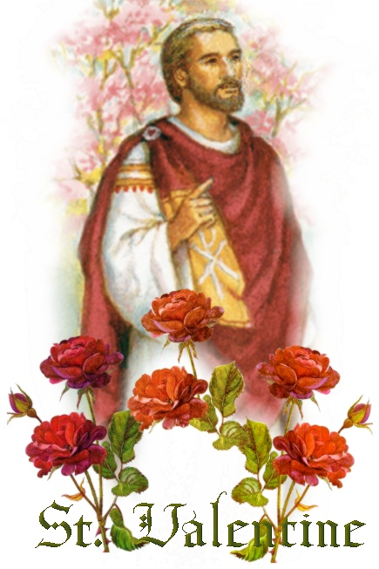
History of Valentine’s Day

Slide 3
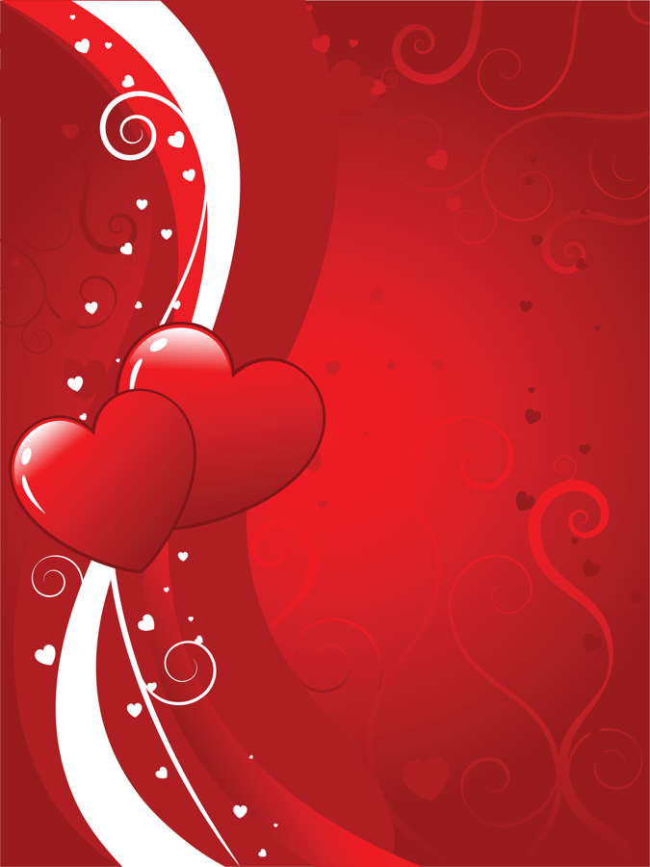
Origins of Valentine’s Day
Many saints named Valentine
  No one knows which one is the one for the holiday
Some countries celebrate Valentine’s Day on different days: July 6th, or July 30th

Slide 4
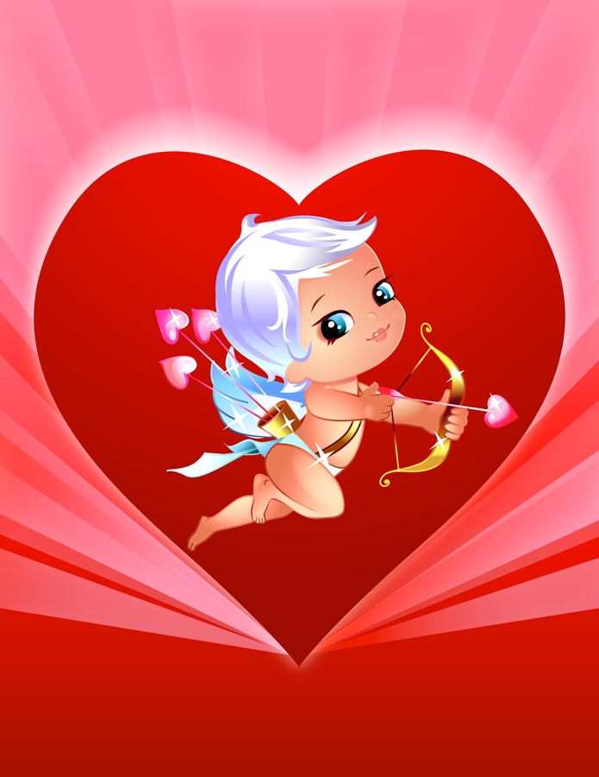
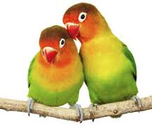
Typical Valentine’s Day Symbols

Slide 5
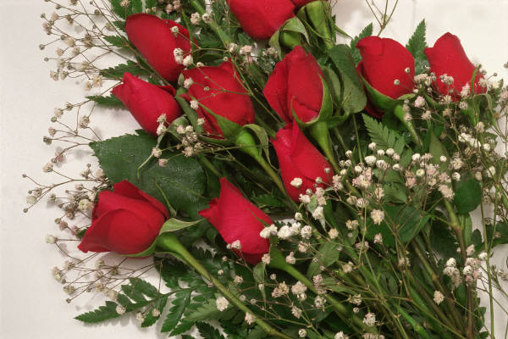
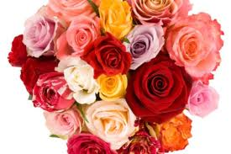
Roses
  Red: Romantic love
  Pink: Admiration, Romance, Beauty
  Yellow: Friendship, Joy (Jealousy)
  White: Purity, Happiness (weddings)
  Lavender: Love at 1st Sight

Slide 6
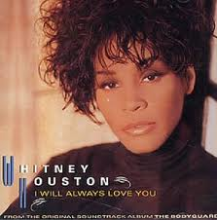
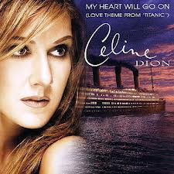
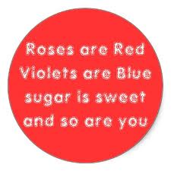
Poems/Songs

Slide 7
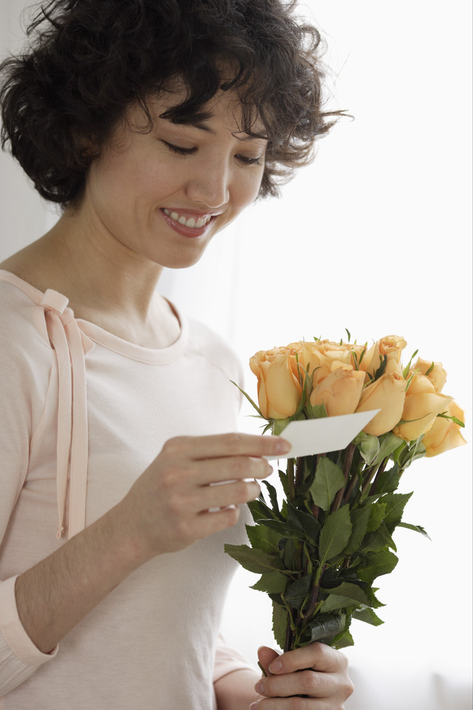
Cards
1,000,000,000 cards are sent each year
Most cards are sweet and romantic
Some cards are funny

Slide 8
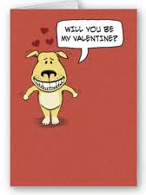
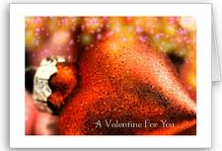
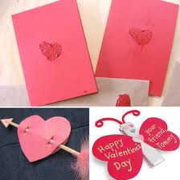
Cards

Slide 9
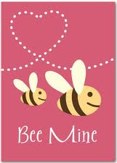
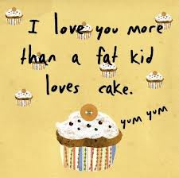
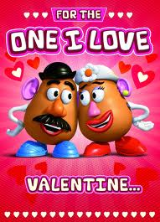
Cards

Slide 10
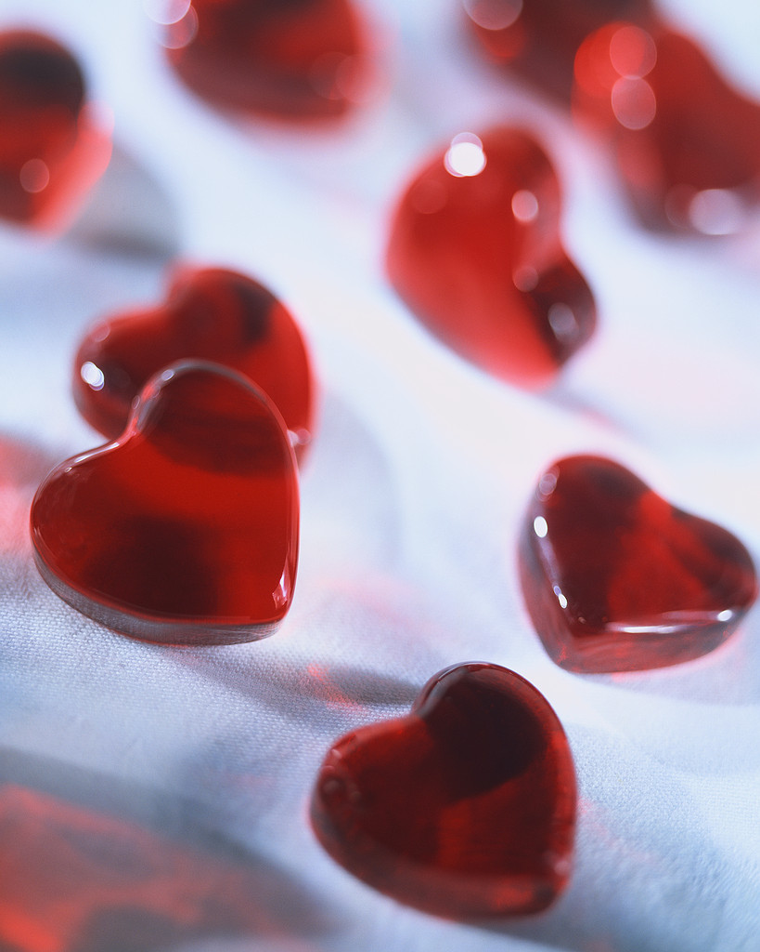
Candy (Chocolate)
Way to make the message “sweeter”
  Americans love sugar
When chocolate became cheaper, many people began to give chocolate as a present

Slide 11
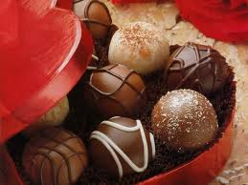
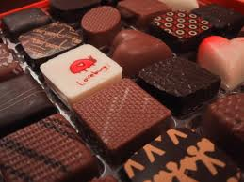
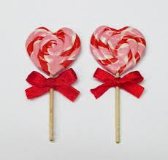
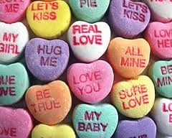
Candy

Slide 12
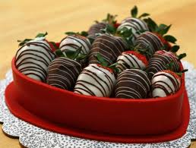
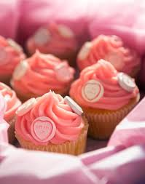

More Candy

Slide 13
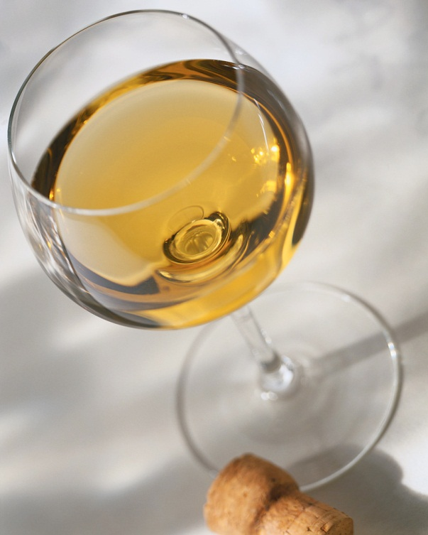
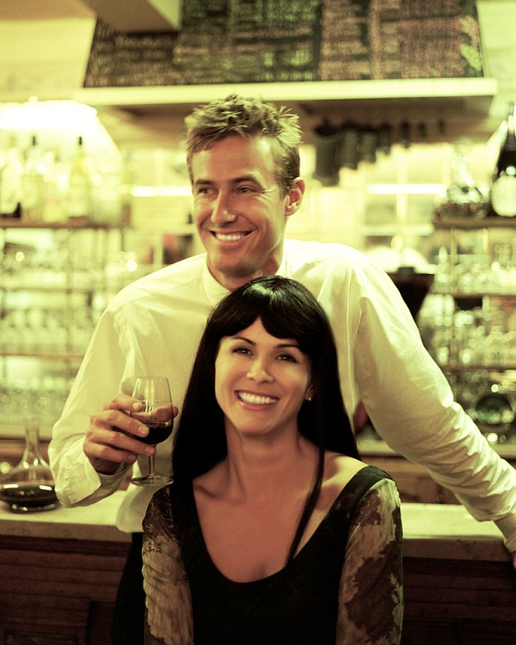
Dinner at a restaurant
Couples go out for a special dinner
Food is very expensive on Valentine’s Day
It’s actually not a good day to go out to eat. Who can guess why?

Slide 14
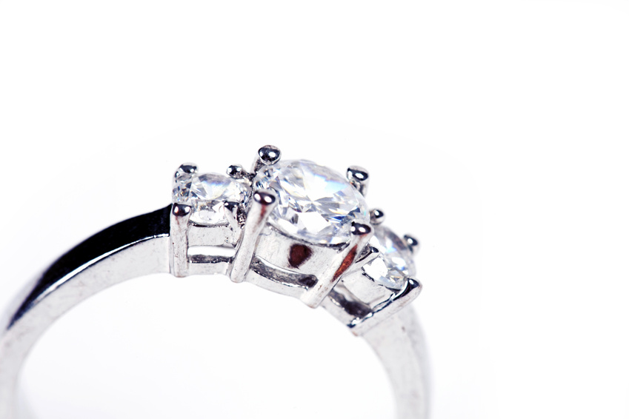
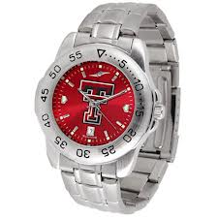
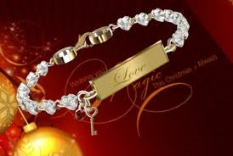
Jewelry
Both men and women get jewelry on Valentine’s Day

Slide 15
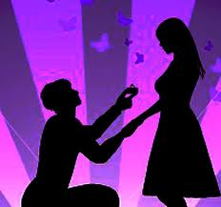
Marriage Proposals
6 million people think they will get engaged on Valentine’s Day
Only 2 million will get engaged
http://www.youtube.com/watch?v=rtBVsCPEy1c

Slide 16
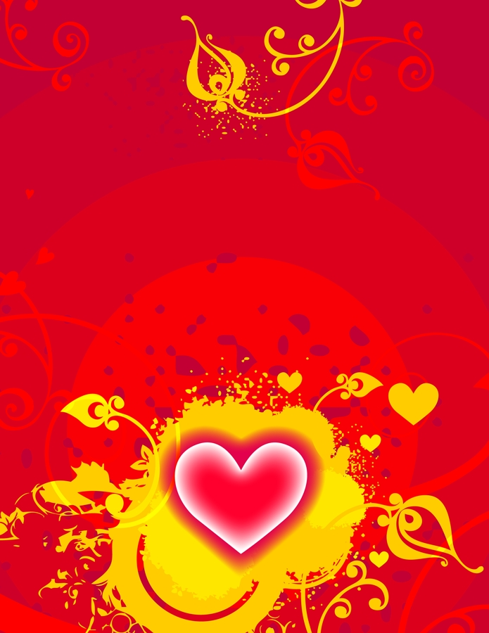
Valentine’s Day Movies
Now, many couples stay home on Valentine’s Day (who can guess why?)
They make dinner or order dinner and watch a movie
Almost all movies watched on Valentine’s Day are “rom-coms”
Guys are very patient

Slide 17
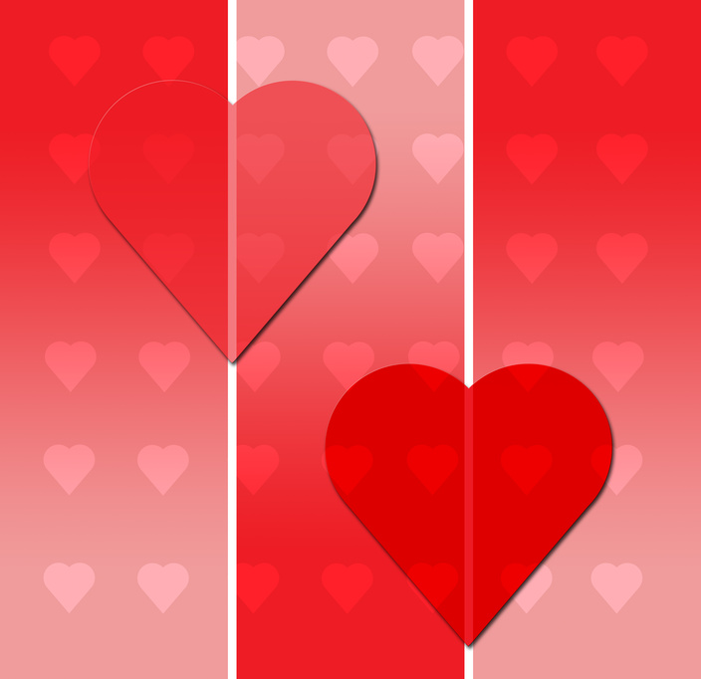
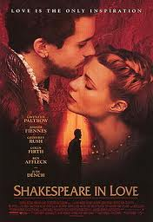
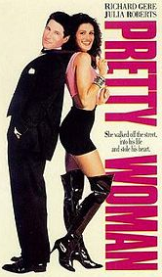
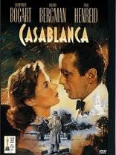
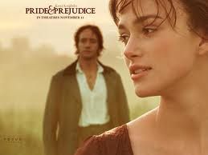
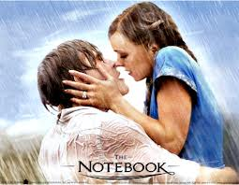
A few classic Valentine’s Day movies

Slide 18
Clips from some Valentine’s Day movies:
The Notebook
Shakespeare In Love
Pride and Prejudice
Pretty Woman
Casablanca

Slide 19
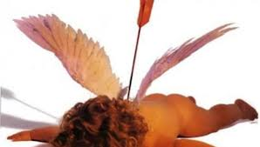
Anti-Valentine’s Day
Some people don’t like Valentine’s Day and don’t celebrate it.
  They just broke up with their partner
  They think it’s just a day to spend money

Slide 20
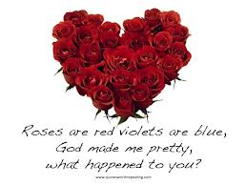
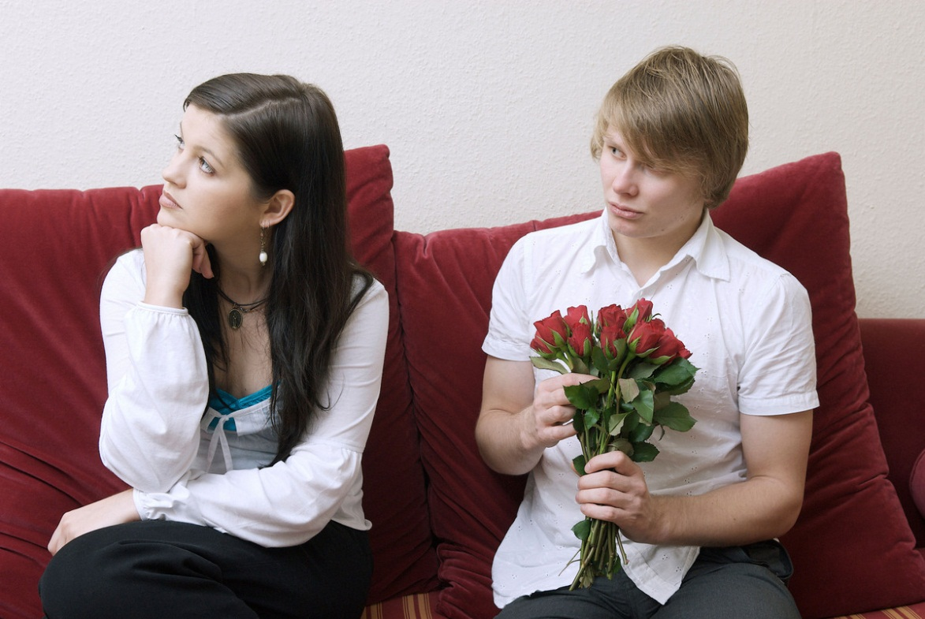
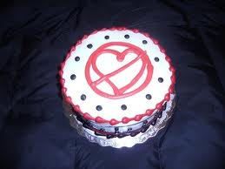

Slide 21

Will you celebrate Valentine’s Day? How?
Do we know who Saint Valentine was?
What presents do people receive on Valentine’s Day?
Why do some people hate Valentine’s Day?
Can you make up a “Roses are red, violets are blue” poem?

